Slide 1
Electronic Instrumentation Section-2, Ppt-21

Slide 2
Analytical instrumentation

Slide 3
Analytical instrumentation is the study of the separation, identification, and quantification of the chemical components of natural and artificial materials.

Slide 4
Classification of Analytical Methods
Qualitative instrumental analysis is that measured property indicates presence of analyte in matrix
Quantitative instrumental analysis is that magnitude of measured property is proportional to concentration of analyte (species of interest) in matrix (all constituents including analyte.

Slide 5
Classical
Qualitative - identification by color, indicators, boiling points, odors
Quantitative - mass or volume (e.g. gravimetric, volumetric)
Instrumental Qualitative - chromatography, electrophoresis and identification by measuring physical property (e.g. spectroscopy, electrode potential)
Quantitative - measuring property and determining relationship to concentration (e.g. spectrophotometry, mass spectrometry)
Often, same instrumental method used for qualitative and quantitative analysis

Slide 6
Application
Environmental Testing
Clinical Analysis
Forensic Analysis
Food & Beverage Analysis
Materials Characterization & research
Pharmaceutical Analysis
Petrochemical testing

Slide 7
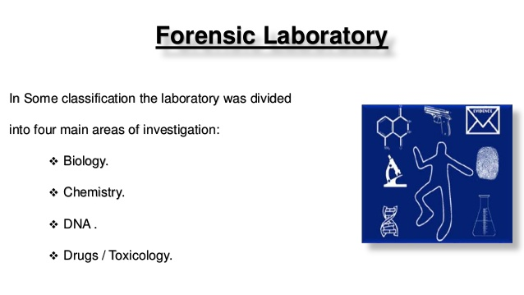

Slide 8
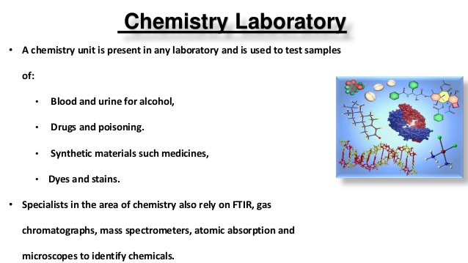

Slide 9
Types of Instrumental Methods:
Property | Example Method
Radiation emission | Emission spectroscopy - fluorescence, phosphorescence, luminescence
Radiation absorption | Absorption spectroscopy -spectrophotometry, photometry, nuclear magnetic resonance, electron spin resonance
Radiation scattering | Turbidity, Raman
Radiation refraction | Refractometry, interferometry
Radiation diffraction | X-ray, electron
Radiation rotation | Polarimetry, circular dichroism

Slide 10
Types of Instrumental Methods:
Property | Example Method
Electrical potential | Potentiometry
Electrical charge | Coulometry
Electrical current | Voltammetry - amperometry, polarography
Electrical resistance | Conductometry
Mass | Gravimetry
Mass-to-charge ratio | Mass spectrometry
Rate of reaction | Stopped flow, flow injection analysis
Thermal | Thermal gravimetry, calorimetry
Radioactivity | Activation, isotope dilution
Often combined with chromatographic or electrophoretic methods

Slide 11
Basic Components of Instrusment
Energy
stimilus
Analyte-matrix
Analytical response
(transducer)
Data process
Data out
In spectrophotometry, the analytical instrument is spectrophotometer:
Mono-chromatic light energy
Light absorption
Photocell
Electrical current
Meter scale
Current meter

Slide 12
Types of Analytical Data Domains
Non-Electrical Domains | Electrical Domains
Physical (light intensity, color), Chemical (pH) | Analog | Current
 |  | Voltage
 |  | Charge
Scale Position (length) | Time | Frequency
 |  | Phase
 |  | Pulse width
Number (objects) | Digital | Count
 |  | Serial or Parallel

Slide 13
Selecting an analytical method
How reproducible? - Precision
How close to true value? - Accuracy/Bias
How small a difference can be measured? - Sensitivity
What range of amounts? - Dynamic Range
How much interference? - Selectivity
How many samples? – Efficience (time, money cost)

Slide 14
Thank you

